Slide 1
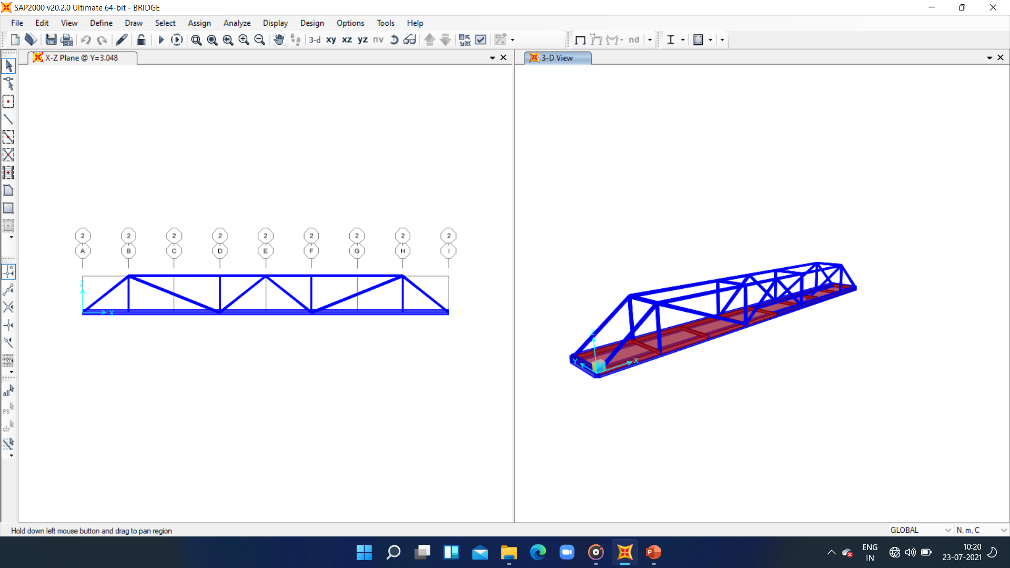
STRUCTURE SUPER COMBO
DESCON SOCIETY
FINAL PROBLEM
PART : 4

Slide 2
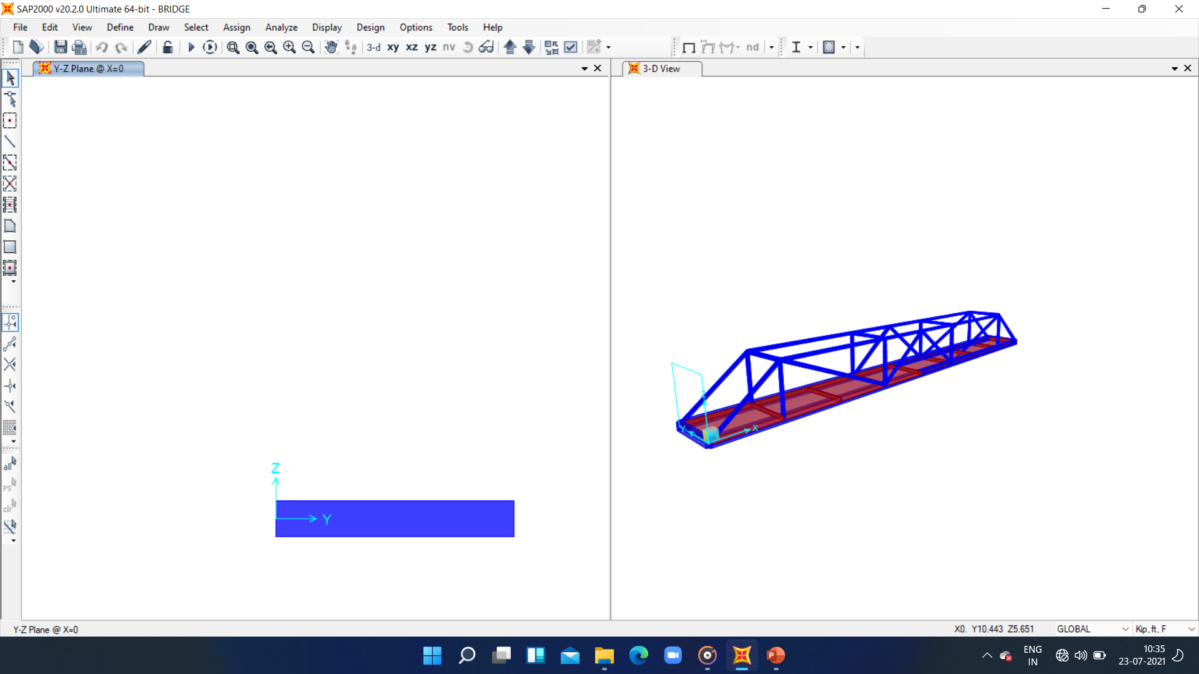
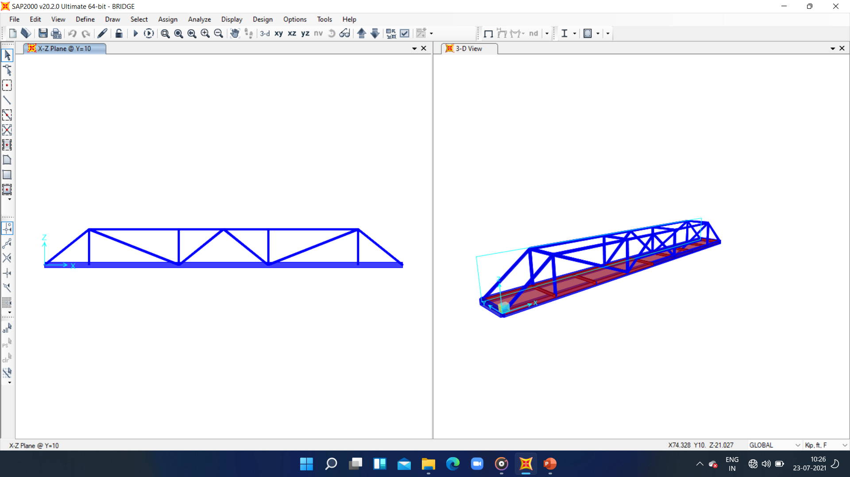
DIMENSIONS OF BRIDGE
LENGTH = 100 ft.
WIDTH = 10 ft.
HEIGHT = 10 ft.

Slide 3
DIFFERENT MATERIALS USED :
CONCRETE 4000Psi
Steel ASTM A500 Grade B
Total structures used:
Beam=4
Pipes =33
Slab =8

Slide 4
Procedure:
Define grid
Define materials to be used and structures
Draw model and fix the bridge
Mess the area part
Apply loads and forces due to gravity self weight and wind.
Analyse the model by checking if all the members pass the tests of frame

Slide 5
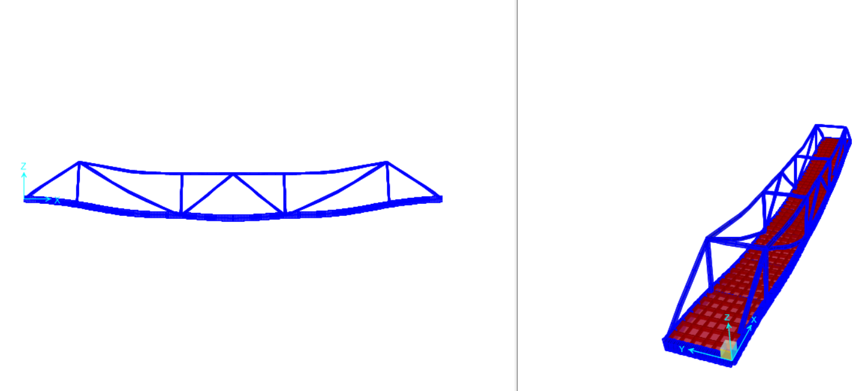
Reason to use such bridge→
Concrete beam is used for support because it requires less maintenance and lasts for over 100 years.
Steel used for upper frame helps to ensure safety so no one falls from height and has less weight.

Slide 6
THANK YOU
By: PRIYA SINGH
Roll No.:200728

